Slide 1

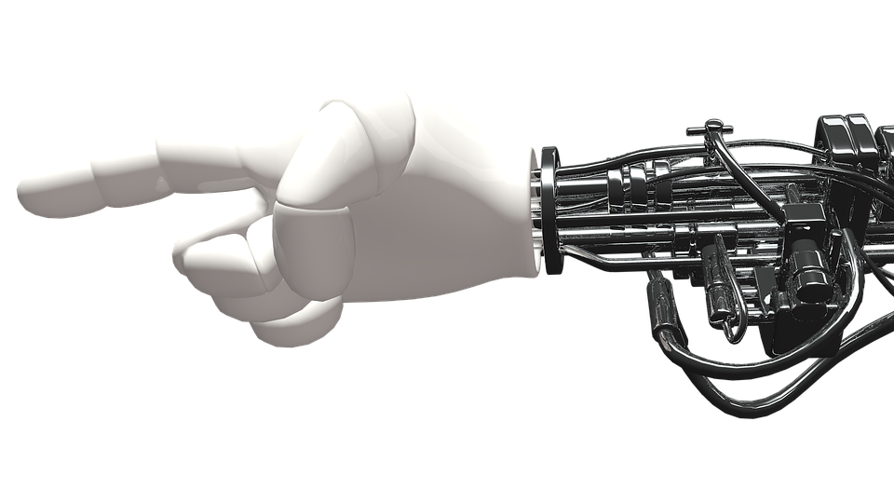
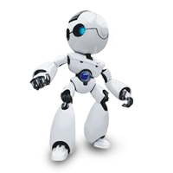

Quantum Machine Learning
: krishnakumarsekar/awesome-quantum-machine-learning

Slide 2
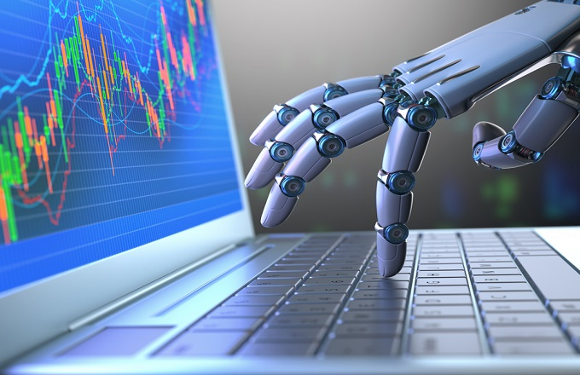
Quantum Machine Learning
: krishnakumarsekar/awesome-quantum-machine-learning

Slide 3

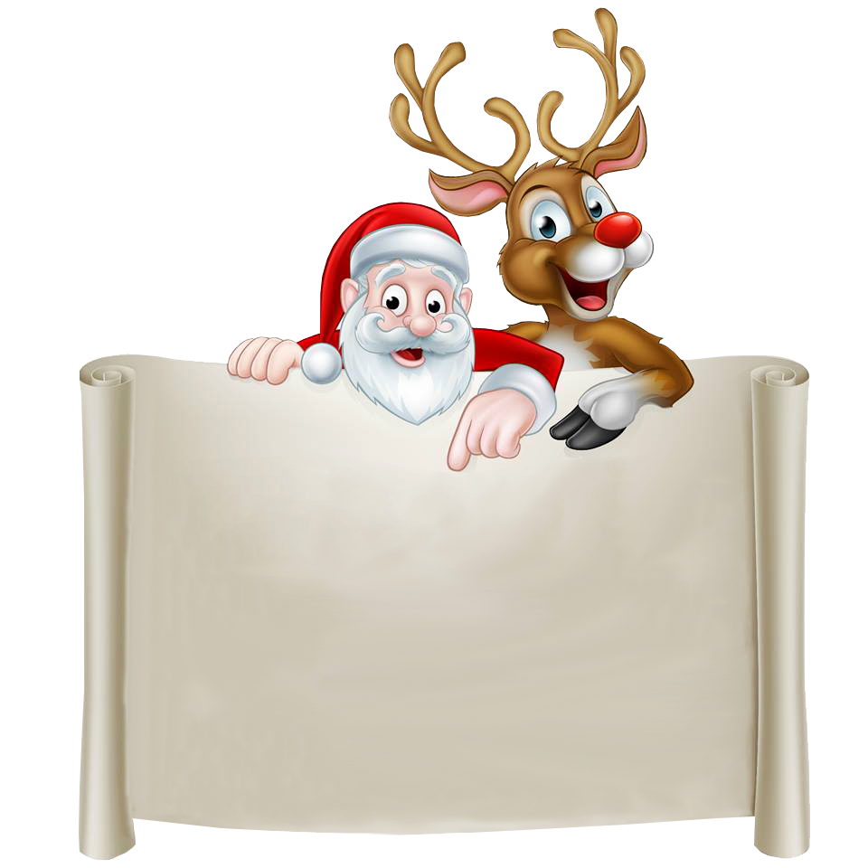

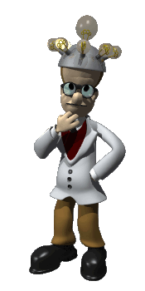
Well for two reason
You know I am holding a PhD degree . But for me I am still a 1’st standard kid in the world of science and not passed the exam yet
To Help for the juniors as not to learn from scratch everything. To Kick start for the future with an easy and correct basic understanding
Dear Professor why you are still learning in age 70 and after completing PhDs, Post Doctorate and Plenty of Publications
Interesting as professor said for our topic we no need to restart from scratch as we have some basic understanding of Quantum. I collected some comments for the topic from internet and prepared how people understood it

Slide 4
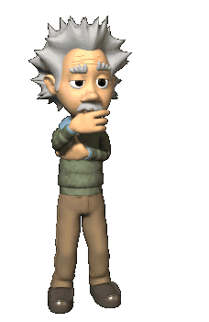

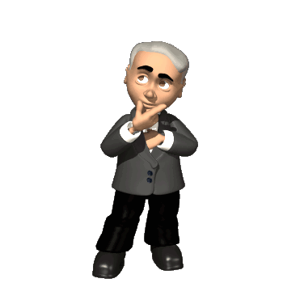








Have you heared about Quantum Machine Learning ?
01
Is it a physics subject thinking so ,Its mostly about atoms ,particles etc
Any idea what is Quantum Machine Learning ?
02
Yes, I heard about quantum computer , how machine learning can be applied to the quantum computer , No idea on that
QML is raising research concept you know ?
03
Ya , I heard about Quantum Spritology ,I need more help on that , Is any one conducting session on that…….
Is Quantum Machine Learning the future ?
04
I am a Bio Technology Student, I heard about something like Quantum Biology , Is the concept to apply machine learning to biology………….

Slide 5






Before Going deep into the topic. We just walkthrough the recent technologies boomed in the last 5-6 years
Artificial Intelligence
Machine Learning
Computer Vision
Augmented Reality

Slide 6






Statistics
Big Data Analytics
Natural Language
Processing
Artificial Neural Net and Deep Learning

Slide 7
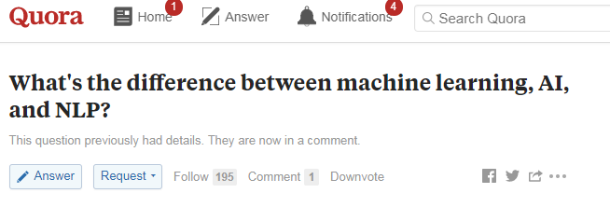
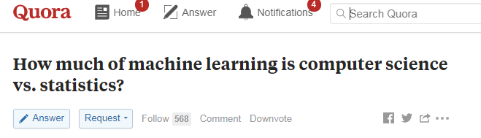
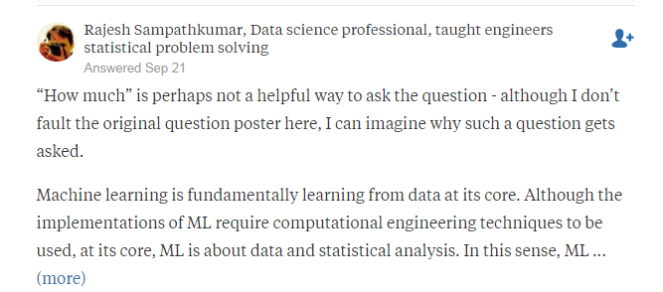
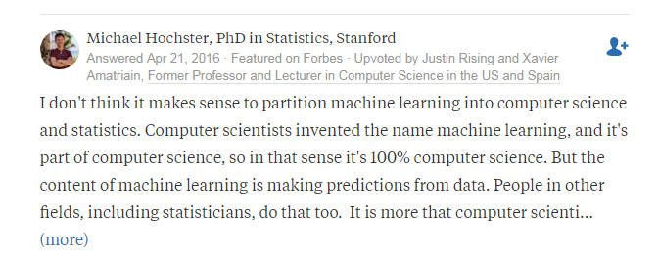

Slide 8
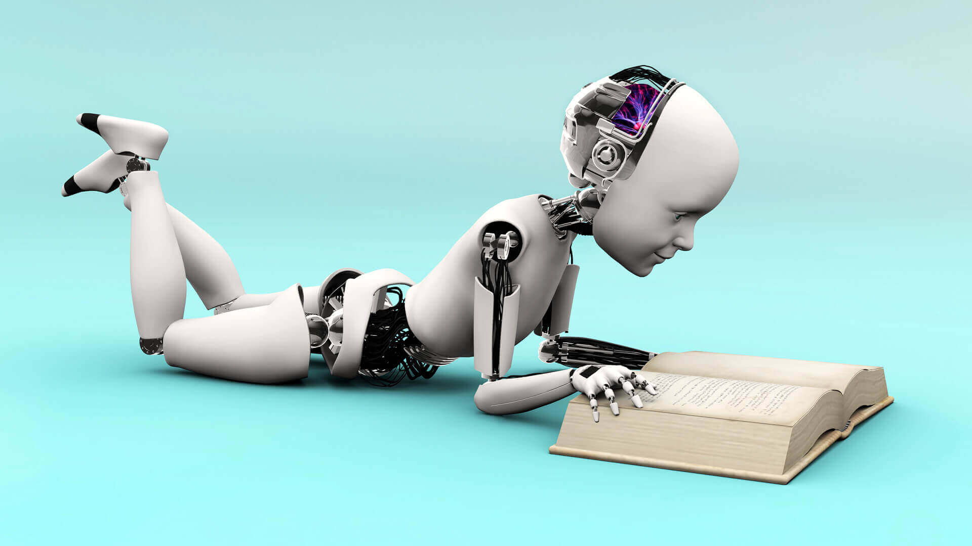
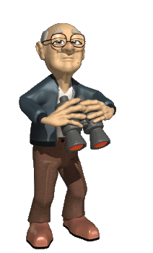

Almost tired after reading all these separate. Let sort out with an example which having applications of all and analyze what is missing and what we have to achieve . A good Example waiting

Slide 9
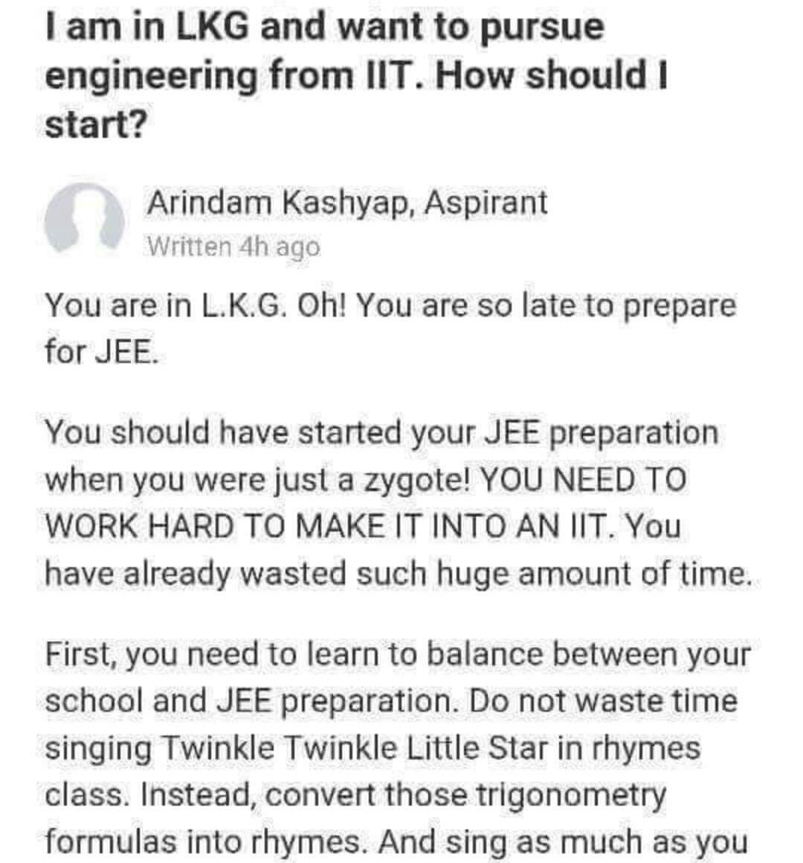

Slide 10

EXAM
What is EXAM ? and What we have to do for the EXAM ? and How to success ?
Exam is a way to test how effective a person knowledge and Reasoning ability. Well Preparation make a success
Preparation
What is preparation?. How to prepare and what sort of preparation will give success
Learning is the key factor to success . Collecting all Books ,Previous Years Question Papers and doing Inferences on the most asked questions and studying the same will make a success
Well Remembering
Books and Study Materials are too heavy and its not easy to remember all in exam time. How to remember easily?
Four factors can help 1.Monitoring Key points along with Page Number ,2. Scanning if any Diagram representation available, 3. Translating the logical explanation in a regional language 4. Writing down what learned and train again and again
?
?
?
Notes:
Download more templates from http://fppt.com/

Slide 11
Reasoning
Artificial Intelligence
Learning, Studying
Machine Learning
Key points,
Page Number
Computer Vision
Scanning, Diagram
Representation
Augmented Reality

Slide 12
Inferences
Statistics
Books ,Previous Years
Question Papers
Big Data
Natural Language
Processing
Translating,
Regional Language
Artificial Neural Net and Deep Learning
Train again
and again

Slide 13
EXAM
What is EXAM ? and What we have to do for the EXAM ? and How to success ?
Exam is a way to test how effective a person knowledge and Reasoning ability. Well Preparation make a success
Preparation
What is preparation?. How to prepare and what sort of preparation will give success
Learning is the key factor to success . Collecting all Books ,Previous Years Question Papers and doing Inferences on the most asked questions and studying the same will make a success
Well Remembering
Books and Study Materials are too heavy and its not easy to remember all in exam time. How to remember easily?
Four factors can help 1.Monitoring Key points along with Page Number ,2. Scanning if any Diagram representation available, 3. Translating the logical explanation in a regional language 4. Writing down what learned and train again and again
Tricky Questions, Not mostly asked question and some out of syllabus
If the Exam its possible to ask some tricky question, Not seen questions etc. How to face them and solve?
There is no meaning for the word tricky unless you studied well and completed all the materials well. Your wrong understanding and assumption be the reason. If you have smart knowledge even if you studied well you can solve some questions which is not from book
Notes:
Download more templates from http://fppt.com/

Slide 14
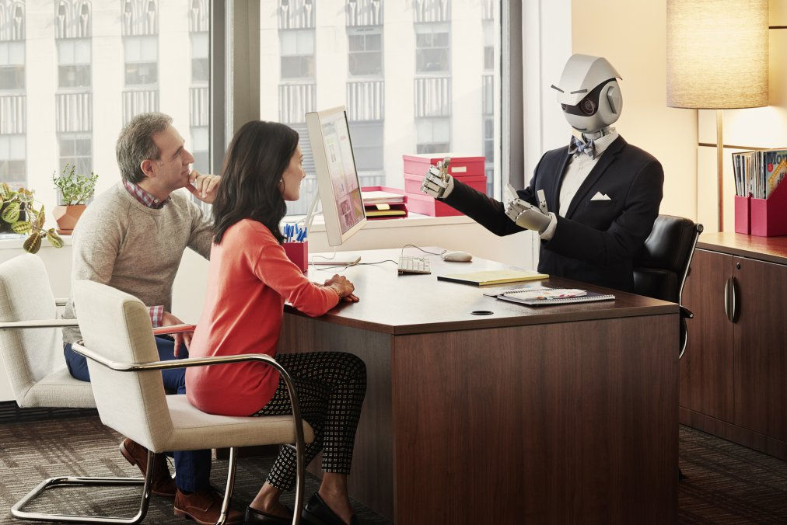

A Better Example for this case is if you are a developer and searching for some answers in stackoverflow ,you eye always go for the high rated answers. But High rated answers not always works and sometimes low rated answers be more effective for your situation

Slide 15
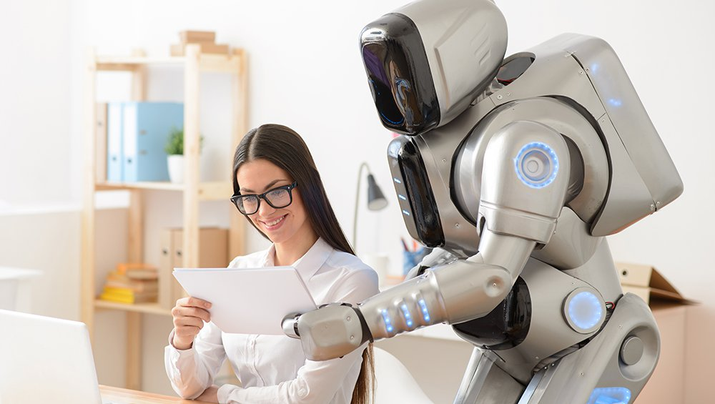

So where comes this problem? And what technically missing to achieve a 100 percent success ?
The answer is simple doing “Optimization” . Starting from floating point number to Gradient Descent(first order derivative) plenty of small data’s we are neglecting in each step and mainly because of computation complexity(Not Power). Really speaking its not power .we don’t have effective way to represent it in Digital

Slide 16
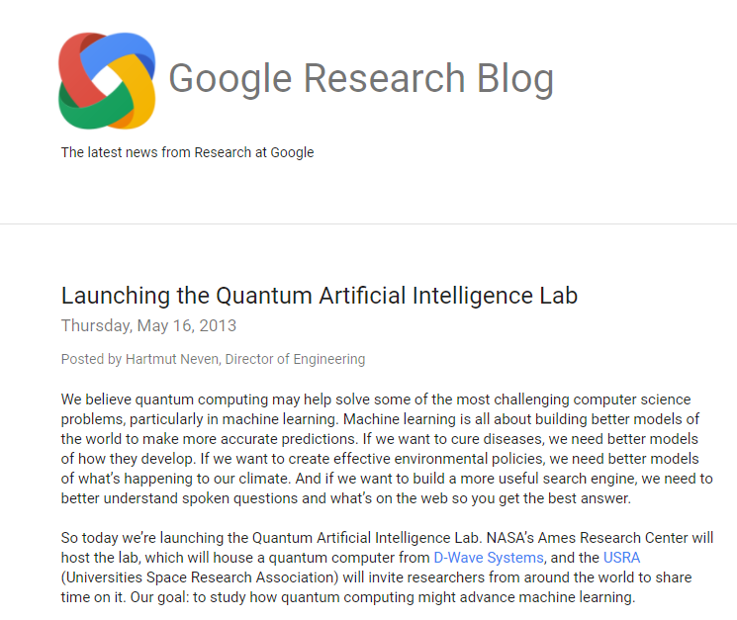
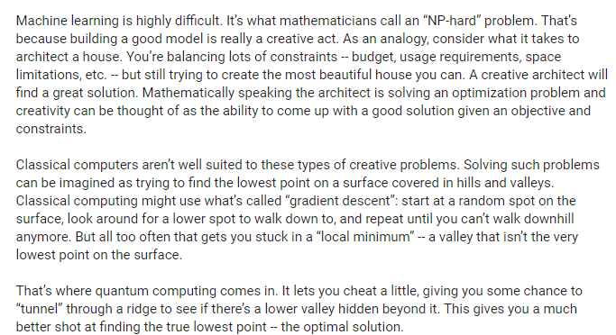

Slide 17



Is
Will Solve
this
Quantum Computer
?

Slide 18




Slide 19




Slide 20


Then what is the solution ?. Why we cannot represent it in Digital ? And What makes the optimization more effective?
The solution is Quantum Supremacy(for google) in technical terms hybridization. Combining classical with quantum. Lets start with step by step

Slide 21
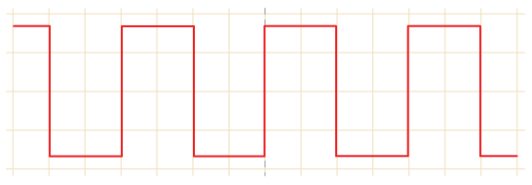
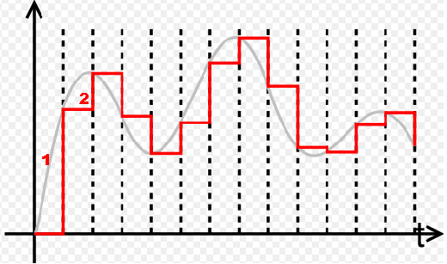
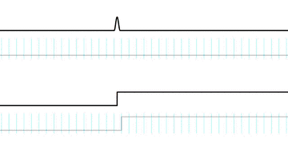
Atom Excited State
and Ground State
Logic Gates
Transistor
VLSI
OSS
Simple Linear Regression Modal

Slide 22
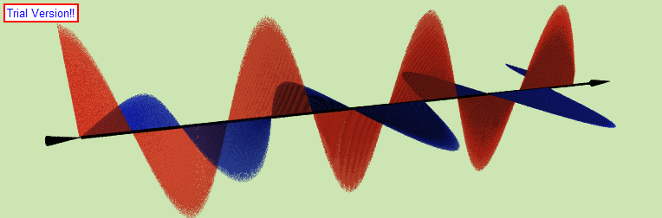
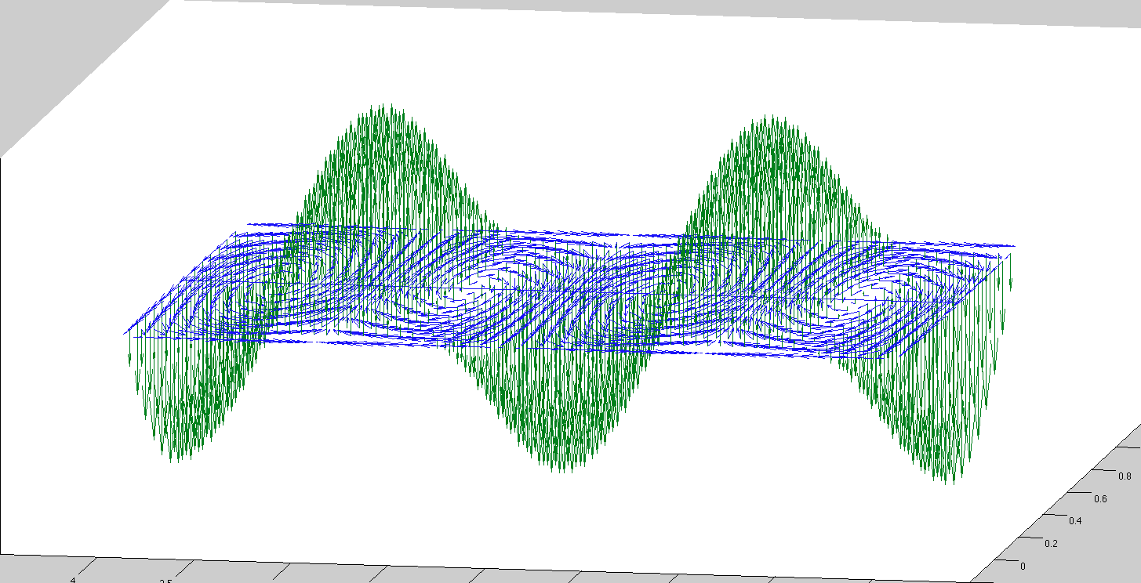
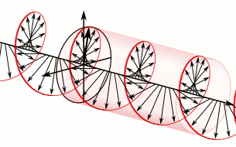
Simple Linear Regression Modal
State Preparation using
amplitude and phase
Quantum State
Triggering Unit
Superposition
Monitoring and analyse the output
State Monitoring

Slide 23

01
Tensor Space Network
A very Powerful Concept to prepare state
02
Quadratic Unconstrained Binary Optimization
Most Complicated Problem in optimization
03
Complex Numbers and Hamiltonian Calculus
Will Change the Quantum Computer in a new form
04
Quantum Neural Network
An under research will change the whole machine learning world

Slide 24
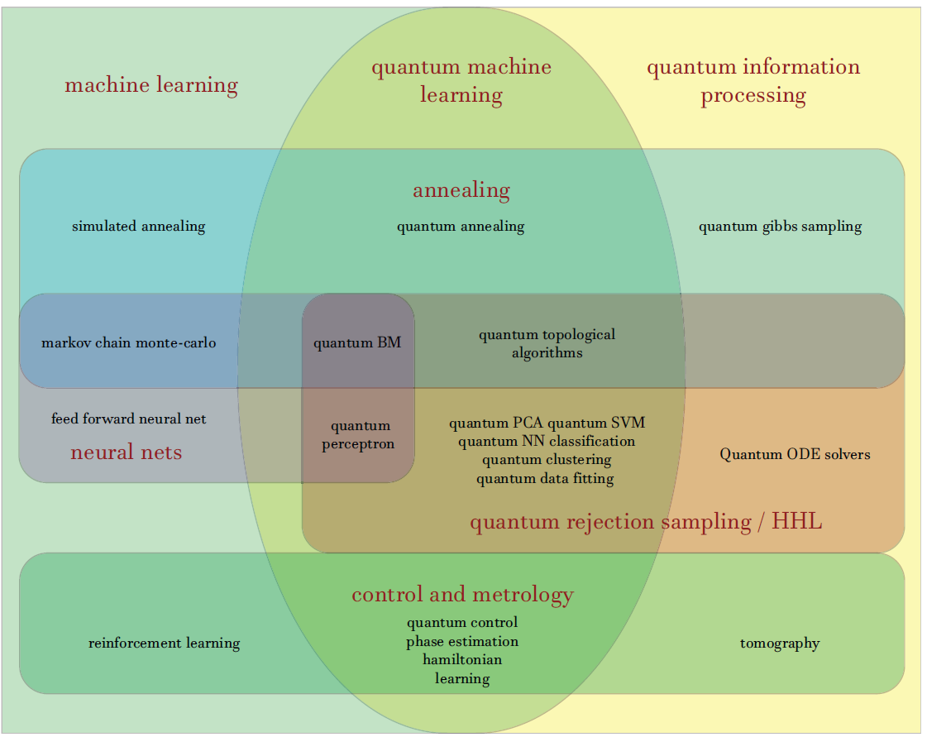

Slide 25



The List of Possible Areas having Applications are
Fingerprint Recognition
Data Hiding
File Compression and No Data loss
Medical Image Segmentation and Processing
3D Image Processing
Auto Programming
Chemicals Extraction and analysis

Slide 26











https://github.com/krishnakumarsekar/
https://KAGGLE.com/krishnakumarsekar
https://www.linkedin.com/in/krishna-kumar-sekar-9a090048/
https://www.facebook.com/Krishnakumar.s1
krishnakumar070891@gmail.com
https://stackoverflow.com/users/1154348/krishnakumar-sekar
https://www.quora.com/profile/Krishna-Kumar-Sekar

Slide 27
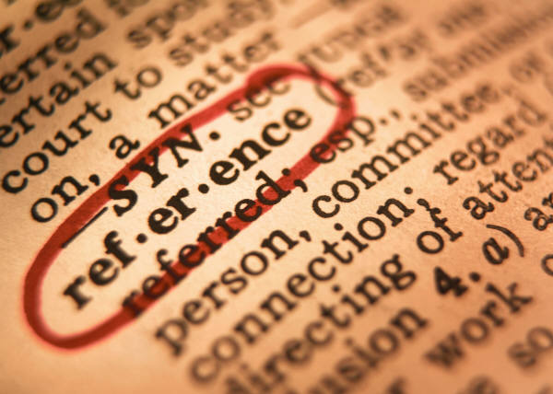
https://www.dynatrace.com/platform/artificial-intelligence/
https://cloud.google.com/blog/big-data/2016/12/google-bigquery-public-datasets-now-include-stack-overflow-q-a
https://www.loomsystems.com/
https://www.forbes.com/sites/janakirammsv/2017/07/04/meet-the-startups-that-bring-artificial-intelligence-to-log-management-and-analysis/#659bf97e7d3f
https://ai.stackexchange.com/questions/3258/design-ai-for-log-file-analysis

